Slide 1
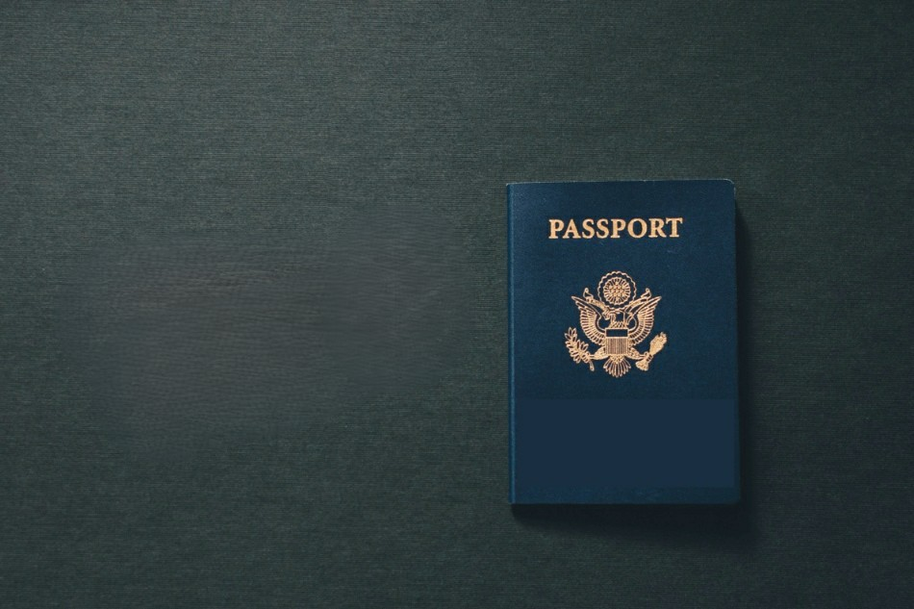
OCR Solution for Passport Data Extraction

Slide 2















Solution Framework
Image Preprocessing
MRZ Extraction
Text Detection
Data Parsing
Resize and clean image
Use PassportEye to read MRZ.
Apply EasyOCR on the image.
Extract and parse relevant fields (Name, DOB, DOI, etc.).
Notes:
Mention top features and that it’s available in other data sources (ctrs and pm)

Slide 3


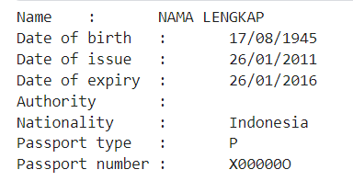
Solution Engine
OCR Engine
Name
DOB
DOE
Nationality
Passport Type
Passport Number
MRZ Extraction
Text Detection
Date of Issue
Authority
Data Parsing
Notes:
Adjust arrows

Slide 4

Code Building Blocks
Date Parsing Methods
String Cleaning and Country Code Methods
Extracting Data from Passport Image
Authority and Issuing Date Extraction
Printing and Data Extraction Methods
Notes:
### 1. **Importing Necessary Libraries**
```python
import os
import string as st
from dateutil import parser
import matplotlib.image as mpimg
import cv2
from passporteye import read_mrz
import json
import easyocr
import warnings
import tempfile
import re
warnings.filterwarnings('ignore')
```
- **os**: Interacting with the operating system (e.g., file handling).
- **string as st**: String operations.
- **dateutil.parser**: Parsing dates in various formats.
- **matplotlib.image as mpimg**: Handling image files.
- **cv2**: OpenCV library for image processing.
- **passporteye.read_mrz**: Reading Machine Readable Zone (MRZ) from passports.
- **json**: Handling JSON files.
- **easyocr**: Optical Character Recognition (OCR) library.
- **warnings**: Suppressing warnings.
- **tempfile**: Creating temporary files.
- **re**: Regular expressions for pattern matching.
### 2. **Defining the Class `PassportDataExtractor`**
```python
class PassportDataExtractor:
def __init__(self, country_codes_file, gpu=True):
self.reader = easyocr.Reader(lang_list=['en'], gpu=gpu)
with open(country_codes_file) as f:
self.country_codes = json.load(f)
```
- **Constructor (`__init__` method)**: Initializes the OCR reader and loads country codes from a JSON file.
- **easyocr.Reader**: Initializes the OCR reader with English language support and GPU usage.
### 3. **Date Parsing Methods**
```python
def parse_birth_date(self, date_string):
try:
date = parser.parse(date_string, yearfirst=True).date()
if date.year >= 2000:
date = date.replace(year=date.year - 100)
return date.strftime('%d/%m/%Y')
except ValueError:
return None
def parse_date(self, date_string):
try:
date = parser.parse(date_string, yearfirst=True).date()
return date.strftime('%d/%m/%Y')
except ValueError:
return None
```
- **parse_birth_date**: Parses birth dates, adjusting years if necessary.
- **parse_date**: General date parsing.
### 4. **String Cleaning and Country Code Methods**
```python
def clean(self, string):
return ''.join(char for char in string if char.isalnum()).upper()
def get_country_name(self, country_code):
for country in self.country_codes:
if country['code'] == country_code:
return country['name']
return country_code
```
- **clean**: Cleans strings to include only alphanumeric characters.
- **get_country_name**: Converts country codes to country names using the JSON file.
### 5. **Authority and Issuing Date Extraction**
```python
def find_authority(self, ocr_text):
keywords = ['ISSUING AUTHORITY', 'ISSUED BY', 'AUTHORITY', 'ISSUING OFFICE', 'PLACE OF ISSUE']
for line in ocr_text:
for keyword in keywords:
if keyword in line.upper():
authority = line.upper().split(keyword)[-1].strip()
return authority
return 'Not Found'
def find_issuing_date(self, ocr_text):
date_patterns = [
r'\d{2}[-/]\d{2}[-/]\d{2,4}',
r'\d{2} \d{2} \d{4}',
r'\d{2} \b(?:JAN|FEB|MAR|APR|MAY|JUN|JUL|AUG|SEP|OCT|NOV|DEC)\b \d{4}',
]
dates = set()
for line in ocr_text:
for pattern in date_patterns:
date_matches = re.findall(pattern, line, re.IGNORECASE)
for date_match in date_matches:
parsed_date = self.parse_date(date_match)
if parsed_date:
dates.add(parsed_date)
if len(dates) >= 3:
dates = sorted(dates, key=lambda x: parser.parse(x, dayfirst=True))
return dates[1]
return 'Not Found'
```
- **find_authority**: Extracts the issuing authority from OCR text.
- **find_issuing_date**: Extracts issuing dates using regular expressions.
### 6. **Printing and Data Extraction Methods**
```python
def print_data(self, data):
for key, value in data.items():
print(f'{key.replace("_", " ").capitalize()}\t:\t{value}')
```
- **print_data**: Prints extracted data in a formatted way.
### 7. **Extracting Data from Passport Image**
```python
def get_data(self, img_name):
user_info = {}
with tempfile.NamedTemporaryFile(delete=False, suffix='.png') as tmpfile:
tmpfile_path = tmpfile.name
try:
mrz = read_mrz(img_name, save_roi=True)
if mrz:
mpimg.imsave(tmpfile_path, mrz.aux['roi'], cmap='gray')
img = cv2.imread(tmpfile_path)
img = cv2.resize(img, (1110, 140))
allowlist = st.ascii_letters + st.digits + '< '
code = self.reader.readtext(img, paragraph=False, detail=0, allowlist=allowlist)
if len(code) < 2:
return print(f'Error: Insufficient OCR results for image {img_name}.')
a, b = code[0].upper(), code[1].upper()
if len(a) < 44:
a = a + '<' * (44 - len(a))
if len(b) < 44:
b = b + '<' * (44 - len(b))
surname_names = a[5:44].split('<<', 1)
surname, names = surname_names if len(surname_names) == 2 else (surname_names[0], '')
name = names.replace('<', ' ').strip().upper()
surname = surname.replace('<', ' ').strip().upper()
full_img = cv2.imread(img_name)
ocr_results = self.reader.readtext(full_img, detail=0)
user_info['Name'] = f"{name} {surname}"
user_info['Date of Birth'] = self.parse_birth_date(b[13:19])
user_info['Date of Issue'] = self.find_issuing_date(ocr_results)
user_info['Date of Expiry'] = self.parse_date(b[21:27])
user_info['Authority'] = self.find_authority(ocr_results)
user_info['Nationality'] = self.get_country_name(self.clean(b[10:13]))
user_info['Passport Type'] = self.clean(a[0:2])
user_info['Passport Number'] = self.clean(b[0:9])
else:
print(f'Machine cannot read image {img_name}.')
finally:
if os.path.exists(tmpfile_path):
os.remove(tmpfile_path)
return user_info
```
- **get_data**: Main method for extracting data from a passport image.
- **read_mrz**: Reads MRZ from the image.
- **easyocr.Reader.readtext**: Performs OCR on the MRZ and full image.
- **parse_birth_date, parse_date, clean, find_authority, find_issuing_date, get_country_name**: Helper methods for extracting and formatting data.

